Slide 1
Executive Information System
An information system designed to cater the specific needs of executives is known as Executive Information System (EIS). It is also known Executive Support System (ESS).
It is an association of many features of Management Information System (MIS) and DSS.
Executive Information System (EIS) is computer-based information delivery and communication system designed to support the needs of top executives. It provides high-level, summarized information to them.
Example: A CEO logs into an EIS dashboard and sees:
Today’s revenue vs target, Region-wise sales performance, Market growth trends, Risk alerts, Competitor comparison. From one screen, they can decide whether to increase marketing in a low-performing region.

Slide 2
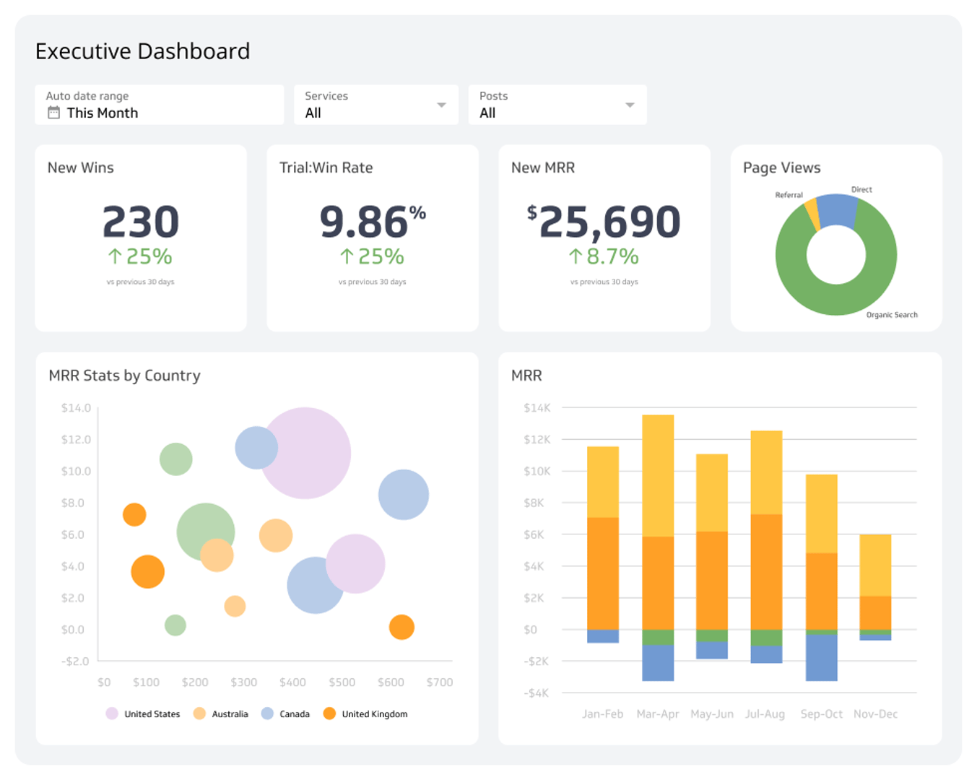

Slide 3
Executive Information System
Characteristics of Executive Information System (EIS):
1) Drill-Down Capabilities :
This helps the executive to get the details from particular information, e.g., drop in corporate sales in a particular region. In systems that use graphical user interface, hypertext-style connections are used for information gathering. In menu-driven systems, sub-menus are used to access the detailed information at each level.
2) Designed with Management's Critical Success Factors In Mind :
Each company has its own critical aspects to achieve the organisational objectives. These aspects can be at the individual, departmental and organisational level.

Slide 4
Executive Information System
3) Status Access, Trend Analysis and Exception Reporting :
This permits executives to get the recent data on any key variable. Trend analysis supports the executive to study data over a given timeline.
4) Navigation of Information :
This allows access of large amounts of data in a very short time span with accurate results. Forward and backward path access, skipping screens while accessing a selected part of the system are the examples of it.
5) Presents Graphical, Tabular and/or Textual Information :
Terminal presentation of gathered information to executive users may be in various formats like textual formats, tabular and/or graphical.

Slide 5
Executive Information System
Advantages of EIS:
Executive Support System or Executive Information System can be easily used by upper level executives for decision-making, as extensive computer knowledge is not required for this.
It has trends analysis capability.
Enhances the manager's leadership skills.
It involves strategic control flexibility.
Leads to healthy competition in the market place.
An executive time horizon is increased.
Leads to a better reporting system.
Helps executives to get a better mental model of business.

Slide 6
Executive Information System
Disadvantages of EIS:
Its functions are limited, as it cannot perform complex calculations.
It is difficult to quantify the advantages and justify its implementation.
Information overload is encountered by executives.
Systems are prone to become slow, large and hard to manage.
Keeping recent data is tough.
Leads to less reliable and insecure data.
Huge cost of implementation encountered by small scale organisations.

Slide 7
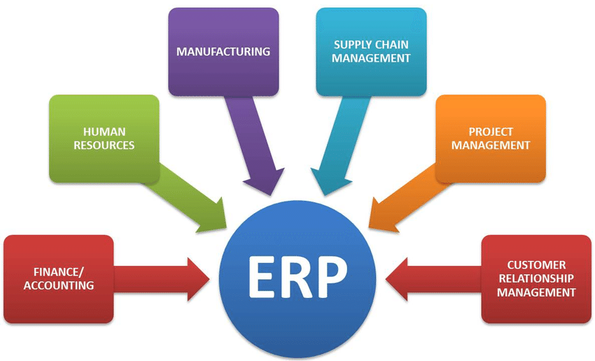
Enterprise Resource Planning:

Slide 8
ERP vs BI:
ERP (Enterprise Resource Planning) is an integrated software system used by organizations to manage and automate core business processes in a single centralized platform.
It coordinates all the resources, information, and functions of a business across departments such as finance, HR, manufacturing, supply chain, and sales.
On the other hand, BI solutions leverage the data stored in the ERP systems to unearth trends and patterns and generate actionable insights. They help users create robust reports and dashboards to gauge complex data and make better decisions.
While ERP software lets users access company-wide data from a centralized location, BI tools thoroughly analyze this information to derive insights and make data-driven decisions.

Slide 9
ERP vs BI:
Aspect | ERP | BI
Scope and Focus | ERP oversees a number of administrative tasks, including payroll, inventory control, reporting, and hiring. | In order to assist businesses in making defensible decisions based on data insights, business intelligence (BI) mostly focuses on reporting and data analysis.
Decision-Making Support | ERP systems are intended to combine several corporate departments and processes, including finance, human resources, supply chain, and manufacturing. | The primary purpose of BI is to support decision-making through data analysis.
Strategic-Level vs. Operational-Level Analytics | ERP is an operational system that provides the company with an accurate operational picture by tracking both operational and transactional data. | BI tools assist strategic decision-making by providing an overview of an organization’s performance at a high level.

Slide 10
ERP vs BI:
Aspect | ERP | BI
OLAP vs. OLTP | ERP is an Online Transaction Processing (OLTP) system that takes up as little space as possible while efficiently collecting transactions in real-time. | BI is an Online Analytical Processing (OLAP) solution with robust analysis capabilities such as dashboards, scorecards, and enhanced visualization.
Agility vs. Efficiency | ERP solutions boost corporate and business process efficiencies in a variety of ways, including increased departmental collaboration, reduced IT expenditures, and quick data access. | BI helps future-oriented organizations become more agile by providing predictive analytics capabilities, enabling them to make strategic decisions based on future market conditions.

Slide 11
Framework of BI:
A business intelligence framework is a strategic approach to conducting business intelligence for better decision-making.
It helps to ensure that all relevant data is brought to bear, that data is clean and validated, and that the data is being applied in context.
Ultimately, a business intelligence framework is a process that allows you to make the most of your data to find optimal solutions to business problems and quickly take advantage of opportunities as they present themselves.
The BI Framework describes the structured flow of how data moves from different sources to analytical tools and finally into decision-making dashboards and reports.

Slide 12
Framework of BI:
It shows the layers and components required to convert raw data into business insights.
Data Sources
↓
ETL (Extract–Transform–Load)
↓
Data Warehouse / Data Marts
↓
Analytics & OLAP Layer
↓
Reporting & Dashboards
↓
Decision Making

Slide 13
Framework of BI:
Data Sources Layer
Contains raw data from multiple systems. Data may be structured or unstructured. Raw operational data is collected from internal and external sources.
Examples: ERP, CRM, databases, files, web data
ETL Layer
Extracts data from sources, transforms (cleans + standardizes) and loads into warehouse. ETL ensures data quality and consistency before storage.
Data Warehouse Layer
A data warehouse stores integrated, subject-oriented, time-variant data for decision support.. Stores historical data. Optimized for analysis

Slide 14
Framework of BI:
Analytics Layer
Analytical tools convert stored data into patterns and trends. It is responsible for OLAP operations, Data mining, Statistical analysis and Predictive modeling.
Presentation Layer
Insights are presented through interactive visual reports. It contains Dashboards, Reports, Scorecards and Visual charts.
Decision Layer
Managers and executives use insights. Strategic & tactical decisions are taken. Final insights support data-driven decision making.

Slide 15
Types of BI users:
Within BI, there are four key types of users, each interacting with the system in different ways based on their roles and responsibilities:
Executive Users: These high-level decision-makers (e.g., CEOs, CTOs) use BI tools to monitor key performance indicators (KPIs) and strategic metrics through high-level summaries, dashboards, and visualizations. Their focus is on organizational health and progress toward strategic goals.
Analytical Users: Data analysts, business analysts, and data scientists make use of advanced analytics and visualization tools to identify patterns, trends, and correlations. They are key to transforming raw data into business insights for optimization and forecasting.
Operational Users: These users are involved in daily operations (e.g., team leaders, supervisors). They rely on BI for real-time monitoring of performance metrics and to take quick actions to maintain efficiency and productivity.
Self-Service Users: Self-service users, typically from departments like sales, marketing, and HR, utilize BI tools with drag-and-drop functionality to create custom reports and dashboards. They can explore data independently without heavy reliance on IT.

Slide 16
Best BI practices:
Set clear business objectives:
Determining the most valuable and actionable information enables an organization to determine the data that needs to be collected or sourced and help select the BI system features needed to deliver that information.
Comprehensive user training:
The culture change to becoming a data-driven organization is most achievable when all users are given clear and compelling lessons on the new tools.
Monitor data quality and relevance:
Constant data monitoring is needed to help ensure that results are consistent and trustworthy. As market conditions change, new measures might need to be added or different reporting formats developed to add clarity.

Slide 17
Types of BI users:
Ensure data access to decision-makers:
Companies with a modern data architecture and robust BI adoption enjoy competitive advantage: They are positioned to move even further ahead by adopting real-time decisioning practices and predictive analytics.
BI tools:
Microsoft Power BI
Interactive dashboards
Strong Excel integration
Self-service analytics
Widely used in enterprises

Slide 18
BI tools:
Tableau
Advanced visualization
Drag-and-drop analytics
Strong for storytelling with data
Qlik Sense
Associative data model
Fast in-memory analytics
Good for exploration
SAP BusinessObjects
Enterprise reporting
Pixel-perfect reports
Used in large organizations

Slide 19
BI tools:
Oracle Analytics Cloud
Cloud-based BI
Embedded AI insights
Enterprise scale

